Slide 1
Identifying and evaluating the most attractive pathways for CO₂ and CO utilisation for Europe’s Process Industry
Dennis Krämer, DECHEMA e.V.

Slide 2






Notes:
What matters most to you?
We all benefit from the product made by the chemical industry:
Sport shoes, components for cars, petrochemicals get us moving and flying…
Packaging: fresh foods
Isolation material, low energy houses
Health! Medicine etc.

Slide 3
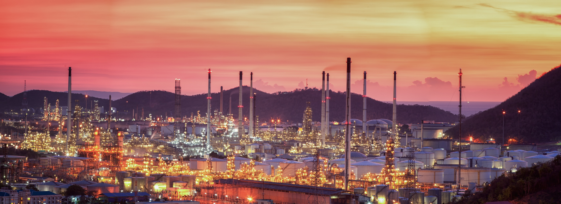
Feedstock of the organic chemistry
Carbon source for the process industry
…at the roots of most value chains
e.g. plastics in Europe:
46,4 Mio. t
Notes:
And the beautiful chemical- well process industries make all the import products that make our life in many cases more easy.
Inhalt:
Plastik in Europa: Packaging, building and construction, automotive, E&E, Others ➔ total 46,4 Mio. t (2010)
20 Mil. T used in the chemical sector (VCI)

Slide 4
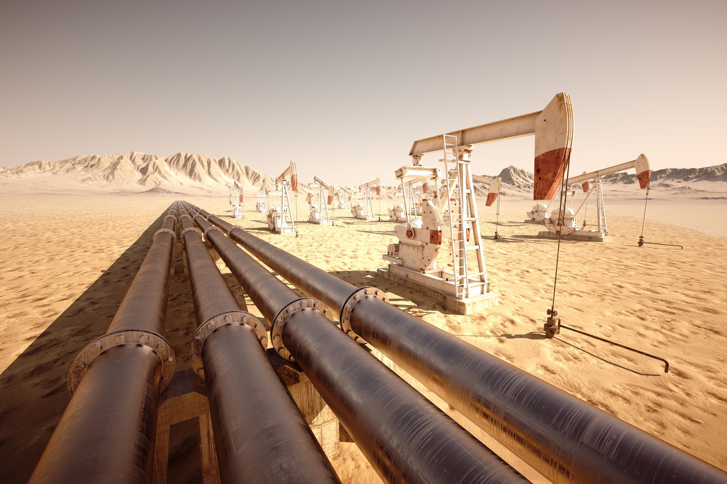
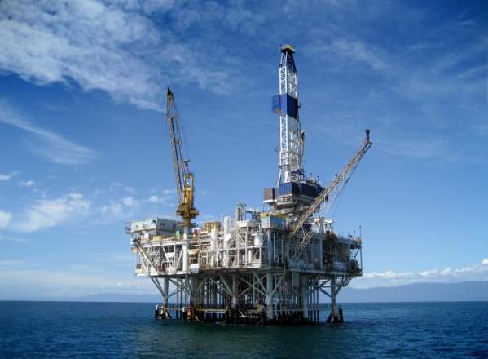
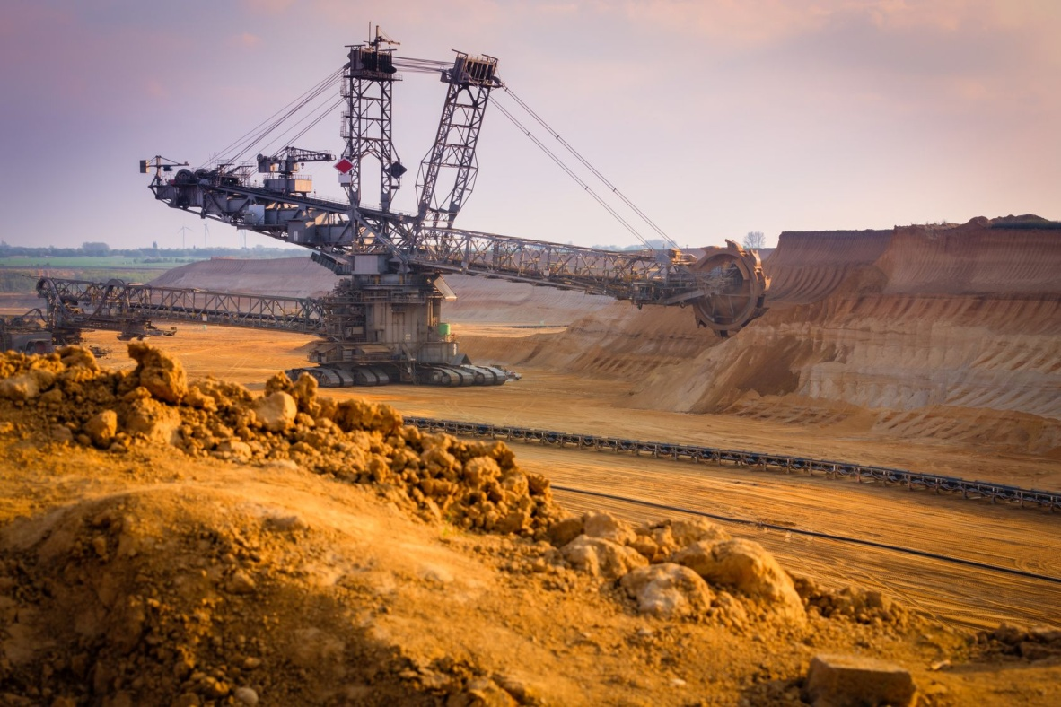
Fossil carbon sources
Notes:
As we all know, the conventional carbon source are fossil ones – oil, gas, coal!

Slide 5


…the whole industry cannot be electrified, yet.
Notes:
You may say there are other options to decarbonize the industry
Such as sector coupling – using renewable electricity etc.
However, there are some areas where electrified solotions are not at the horizion: Airplanes, cargo ships

Slide 6



HORIZON 2020 SPIRE Project
Coordination and Support Action
2016 – 2018
Evaluation of the potential use of CO₂/CO and non-conventional fossil natural resources as feedstock for the process industry in Europe
Notes:
DECHEMA is a non-profit organisation for chemical engineering and biotechnology. DECHEMA’s goal is to promotes theme-based exchange in a large interdisciplinary network, identify trends in research and technology as well as to shapes progress in chemical engineering, biotechnology and
related research fields
Trinomics is an international consultancy that provides research and advice in the fields of energy, environment and climate change
The UK Centre for Carbon Dioxide Utilisation or CDUUK, brings together seven academic departments at the University of Sheffield to focus on the utilization of carbon dioxide as a feedstock for chemical synthesis.

Slide 7
Introduction - CarbonNext
Framework conditions
Acceptance and awareness
Price and availability
Game changers
Carbon sources
Value chains
Products and processes
Industrial symbiosis
Capture and conditioning
Best practice examples
Most relevant products and processes
Business model and economics
Economic potential and environmental impact
Carbon efficiency and LCA

Slide 8
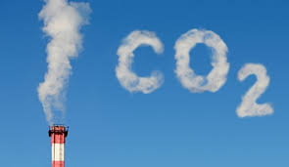
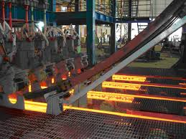
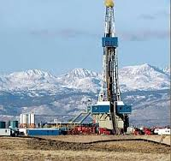
WP1: Mapping
“Unconventional” carbon sources?
CO₂
CO
Shale gas
Heavy oil
Oil shale
Light tight oil
Tight gas
…

Slide 9
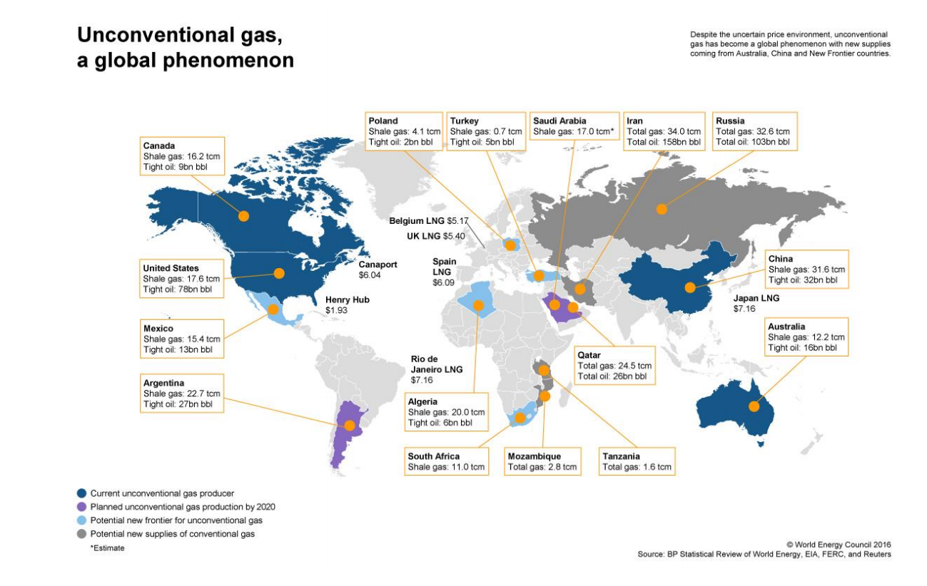
Limited potential
Unconventional hydrocarbon resources in Europe are limited
Only 13 proven crude oil reserves in Europe compared to 226 in the US
Poor drilling results
Environmental concerns are very high
Conclusion: Moratorium in many EU countries
World shale gas & tight oil resources. Source: WEC (2016)
Notes:
Unconventional hydrocarbon resources in Europe are limited. For example, there are only 13 proven crude oil reserves in Europe compared to 226 in the US. Similarly, heavy oil reserves in Europe (0.2 billion barrels of oil in Italy) are a small fraction of the total reserves in the World (59.1 billion barrels of oil). We have identified several production challenges including significant capital investment, environmental issues such as those related to fracking, risk of gas explosions, large water demands and water contamination for CBM’s as well as a need for stable conditions in terms of pressure and temperature which requires a large amount of resources.
We conclude that the potential in Europe is very low and the environmental concerns are very high. We therefore do not foresee that these sources will have an impact on Europe’s processing industry and we propose to disregard them from further research.

Slide 10
Motivation to use carbon dioxide in the process industry
Climate protection
Reduce CO₂ emissions
C source for the process industry
At the roots of most value chains
Energy transition
CO₂ as link for sector coupling
PtX for chemical energy storage
One piece of a puzzle
Replace fossil carbon
Broaden the raw material base
Notes:
It is expected that the main change in CO₂ availability will arise from reductions in emissions arising from coal power generation, which is expected to decrease significantly by 2100. Over the medium term, “clean coal” technologies such as integrated gasification combined cycle or pressurized fluidized bed will improve combustion efficiencies and in the longer term there is expected to be a move away from coal altogether. The relatively ambitious IEA 2°C scenario of the ETP2015 model foresees a reduction of coal as fuel input for electricity and heat generation from 33.8 EJ (10¹⁸ J) in 2012 to 5.1 EJ in 2050, corresponding to a 85% reduction. With around 46 % of the global emissions arising from fossil fuel combustion currently coming from coal reductions in coal use will impact CO₂ availability. However, the impact upon CO₂ utilisation may be limited, as CO₂ from this source is generally of low concentration at 12-14% and can be contaminated with sulphur and heavy metals such as mercury, making capture and purification (clean-up) more expensive. Consequently, it is expected that CO₂ arising from purer sources will be preferentially utilised as described previously Energy Technology Perspectives 2015, IEA
Trends in global CO2 emissions: (2016) PBL Netherlands Environmental Assessment Agency and EC Joint Research Centre.
Chapter 2 Sources of CO2. IPPC Special Report on Carbon Capture and Storage. https://www.ipcc.ch/pdf/special-reports/srccs/srccs_wholereport.pdf

Slide 11
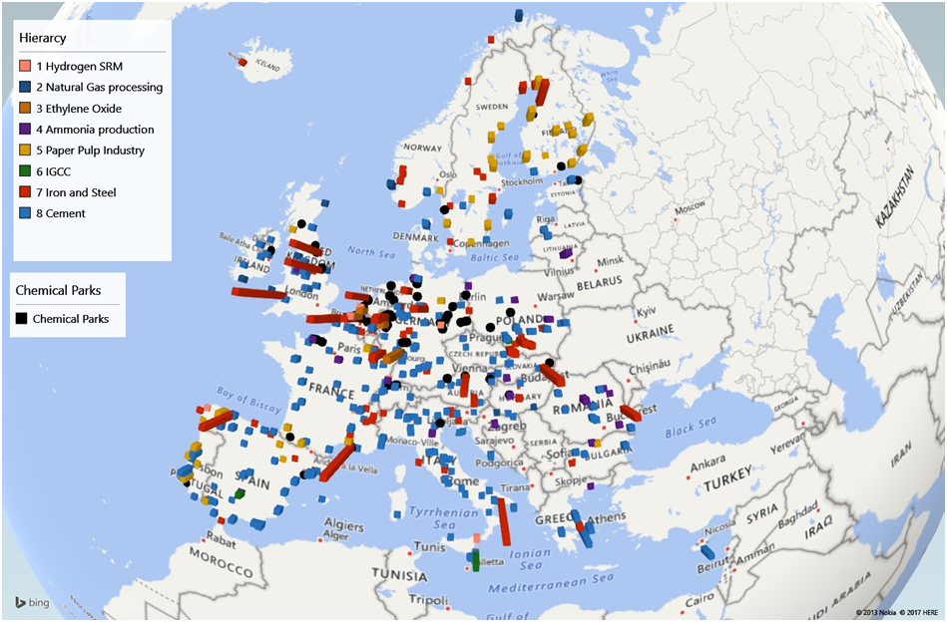
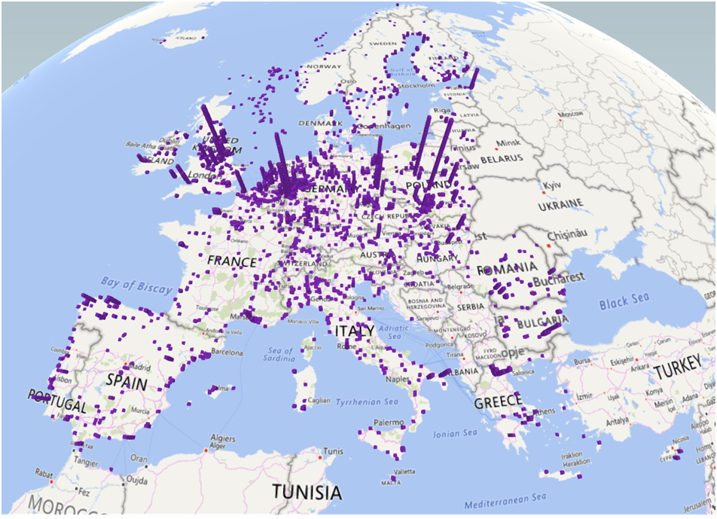
Map of key sources of CO₂ in Europe
(Adapted from E-PRTR)
e-EPTR (European Emission Pollutant and Transfer Register) by the European Environment Agency
  The current E-PRTR lists facilities with CO₂ emissions above 0.1 Mt per year
  CO emissions higher than 0.005 Mt have to be reported in the E-PRTR.
  The register contains data reported annually by more than 30,000 industrial facilities within 9 industrial sectors, covering 65 economic activities across Europe.
2000 point source emitters of CO₂ in Europe
Total emissions of CO₂ in Europe from these facilities amounted to 1,779 Mt in 2014.
Notes:
It is expected that the main change in CO₂ availability will arise from reductions in emissions arising from coal power generation, which is expected to decrease significantly by 2100. Over the medium term, “clean coal” technologies such as integrated gasification combined cycle or pressurized fluidized bed will improve combustion efficiencies and in the longer term there is expected to be a move away from coal altogether. The relatively ambitious IEA 2°C scenario of the ETP2015 model foresees a reduction of coal as fuel input for electricity and heat generation from 33.8 EJ (10¹⁸ J) in 2012 to 5.1 EJ in 2050, corresponding to a 85% reduction. With around 46 % of the global emissions arising from fossil fuel combustion currently coming from coal reductions in coal use will impact CO₂ availability. However, the impact upon CO₂ utilisation may be limited, as CO₂ from this source is generally of low concentration at 12-14% and can be contaminated with sulphur and heavy metals such as mercury, making capture and purification (clean-up) more expensive. Consequently, it is expected that CO₂ arising from purer sources will be preferentially utilised as described previously Energy Technology Perspectives 2015, IEA
Trends in global CO2 emissions: (2016) PBL Netherlands Environmental Assessment Agency and EC Joint Research Centre.
Chapter 2 Sources of CO2. IPPC Special Report on Carbon Capture and Storage. https://www.ipcc.ch/pdf/special-reports/srccs/srccs_wholereport.pdf

Slide 12
Preliminary conclusions on CO₂ sources
There are plentiful sources of CO₂ which could be used as a carbon feedstock for the process industry in Europe.
The most prevalent emitter of CO₂ are power plants. Due to the lower CO₂ concentration in the emissions from the power sector most of the largest emitters are not included in the primary target sources.
First target: Sources with the highest concentration of CO₂ such as:
Hydrogen production
Natural gas processing
Ethylene oxide manufacture
Ammonia production
Notes:
There are plentiful sources of CO₂ which could be used as a carbon feedstock for the process industry in Europe. Primary targets for sourcing CO₂ should focus on those sources with the highest concentration of CO₂, (Hydrogen production, natural gas processing, ethylene oxide manufacture and ammonia production) as the higher concentration of CO₂ reduces the cost of capture. However, larger volumes of CO₂ are available from the iron and steel industry and cement industries, albeit at lower CO₂ concentration. As industries look to decarbonise (particularly the iron and steel and cement sectors) there is an observed market pull to deploy CO₂ utilisation technologies to provide an economically beneficial method of reducing CO₂ emissions. As next-generation carbon capture technologies reach the market, other sources of CO₂ may become increasingly economically viable.
It is expected that the main change in CO₂ availability will arise from reductions in emissions arising from coal power generation, which is expected to decrease significantly by 2100. Over the medium term, “clean coal” technologies such as integrated gasification combined cycle or pressurized fluidized bed will improve combustion efficiencies and in the longer term there is expected to be a move away from coal altogether. The relatively ambitious IEA 2°C scenario of the ETP2015 model foresees a reduction of coal as fuel input for electricity and heat generation from 33.8 EJ (10¹⁸ J) in 2012 to 5.1 EJ in 2050, corresponding to a 85% reduction. With around 46 % of the global emissions arising from fossil fuel combustion currently coming from coal reductions in coal use will impact CO₂ availability. However, the impact upon CO₂ utilisation may be limited, as CO₂ from this source is generally of low concentration at 12-14% and can be contaminated with sulphur and heavy metals such as mercury, making capture and purification (clean-up) more expensive. Consequently, it is expected that CO₂ arising from purer sources will be preferentially utilised as described previously Energy Technology Perspectives 2015, IEA
Trends in global CO2 emissions: (2016) PBL Netherlands Environmental Assessment Agency and EC Joint Research Centre.
Chapter 2 Sources of CO2. IPPC Special Report on Carbon Capture and Storage. https://www.ipcc.ch/pdf/special-reports/srccs/srccs_wholereport.pdf

Slide 13
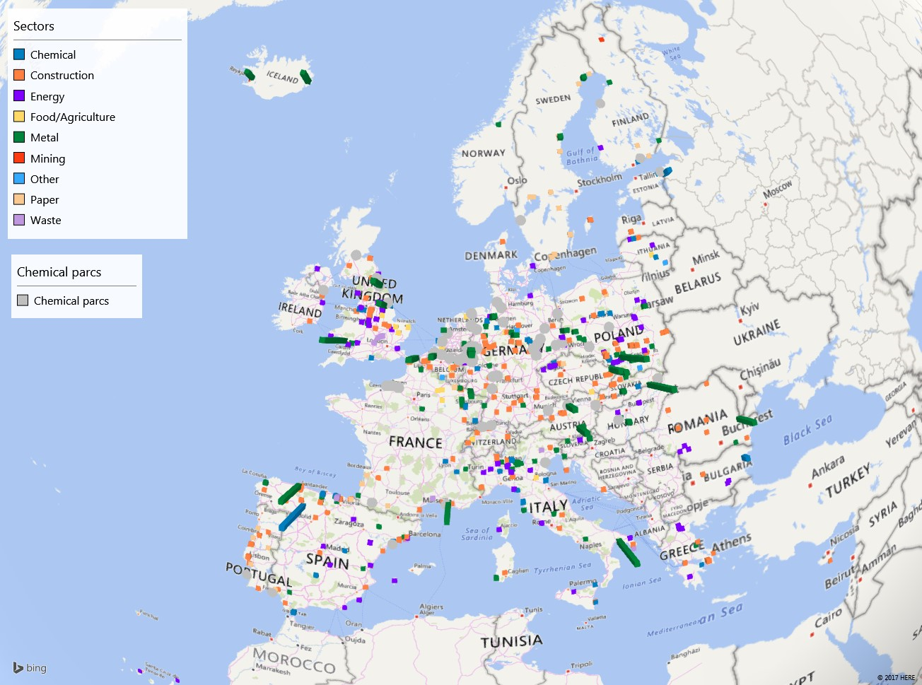
CO emissions and chemical parks
Total CO emissions in the EU: 3.38 Mt
Metal sector is the primary CO emitter in the EU: 2.4 Mt

Slide 14
CO emitted by sectors
Manufacture of iron and steel productes 65% of total CO emissions
Focus on steel industry as main emitter

Slide 15
Main conclusions on CO
Steel industry is the main CO emitter
  Only minor part is emitted and appears at the E-PRTR database
  Most of the is CO used for heating or electrification
  Alternative cross-sectional use is limited at the moment
    political framework conditions (e.g. German renewable energy act, EEG) and infrastructure for transportation
    Chemical/physical processes known, technical feasibility on industrial scale is missing
CO estimation
  Rough estimation possible
  Increase in factor 12-20 for single sources
Notes:
CO can be an alternative C-source if …
significant amounts available (point sources such as SiC factory in Spain)
Consumer close-by, infrastructure easily to install
political framework conditions support alternative usage pathways
technical feasibility of techniques for cleaning, separation and conditioning were shown
Steel industry as point sources
Only CO emitted into the atmosphere is listed
Does not reflect the CO produced as most CO is directly reused on site
Facilities are known
Amount of CO produced could be calculated
Requires detailed information on steel industry and plant facts
Estimation based on single cases (e.g. Duisburg, Germany) prepared
Rough estimation for EU

Slide 16
*All images by Fotolia

